Slide 1
Mininet for AVB system
Prof. Yen-Wen Chen
Student Kuo-Che Kao
2020/4/7

Slide 2
Outline
Introduction
Topology
QoS rule
Result

Slide 3
Introduction

Slide 4
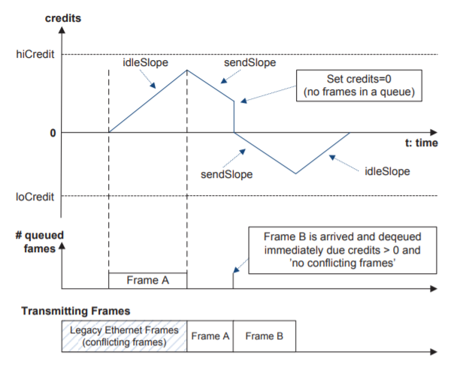
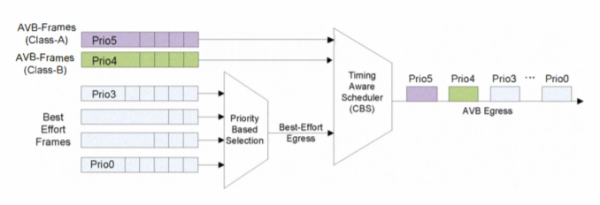
Introduction
According to AVB–credit based shaper:
Simulate this method by mininet and sdn ryu-manager (queue QoS)

Slide 5
Topology

Slide 6
Topology
Node A
10.0.0.1
SR class
Node B
eth1
Switch
Target
eth2
eth4
10.0.0.2
eth3
10.0.0.4
Node C
Best-effort
10.0.0.3

Slide 7
QoS rule

Slide 8
QoS rule
Default :
 | Minimum rate | Maximum rate
Queue 0 (10.0.0.1) | 37.5Mbps | 100Mbps
Queue 1 (10.0.0.2) | 37.5Mbps | 100Mbps
Queue 2 (10.0.0.3) | 0Mbps | 100Mbps
If credit value < 0 :
 | Minimum rate | Maximum rate
Queue 0 (10.0.0.1) | 0Mbps | 100Mbps
Queue 1 (10.0.0.2) | 0Mbps | 100Mbps
Queue 2 (10.0.0.3) | 0Mbps | 100Mbps

Slide 9
QoS rule
Credit value :
If queue bytes change > 0 : credit value +3
If queue bytes change = 0 : credit value -1
If queue bytes change = 0 twice : credit value = 0
-3 <= credit value <=3

Slide 10
Result

Slide 11
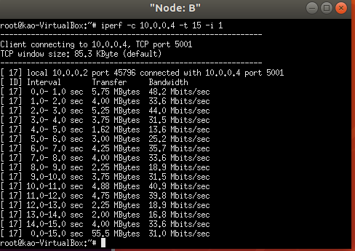
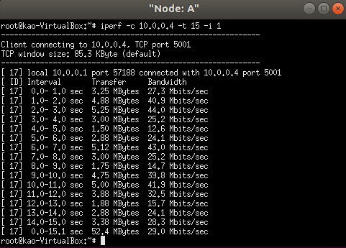
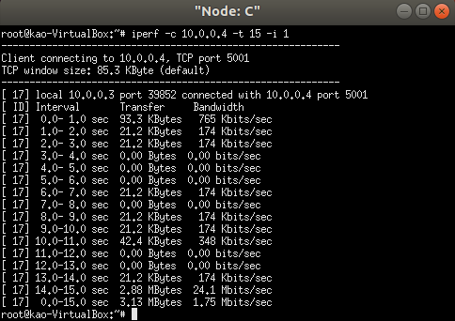
Result
If just use default QoS setting:

Slide 12
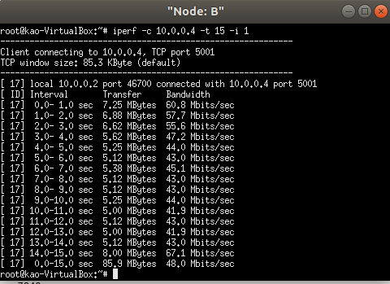
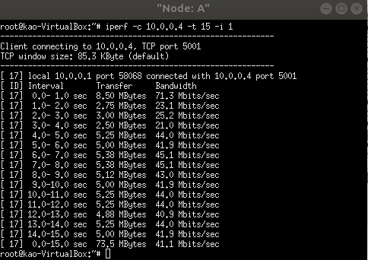
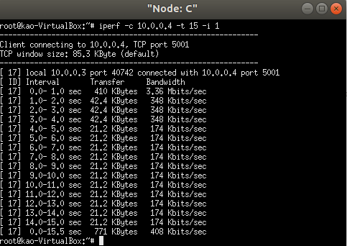
Result
Use credit based shaper:

Slide 13
Reference
Hyung-Taek Lim; Daniel Herrscher; Firas Chaari, ”Performance Comparison of IEEE 802.1 Q and IEEE 802.1 AVB in an Ethernet-based In-Vehicle Network”, 2012 8th International Conference on Computing Technology and Information Management (NCM and ICNIT)

